Slide 1


Deloitte TechnoUtsav 2.0
Theme Alignment: Internet of Things, Data Science/Machine Learning
Industry Alignment: Energy, Resources and Industrials
Category : Tech E
College Name : MPSTME NMIMS
Team Name : Prayaas

Slide 2
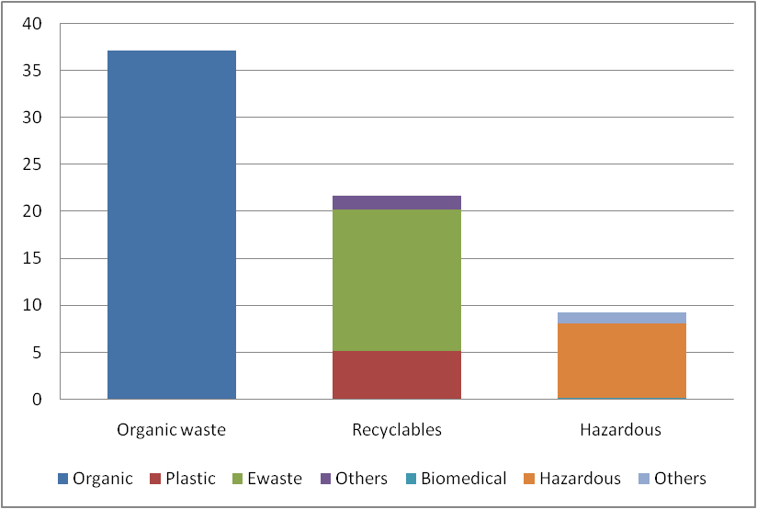
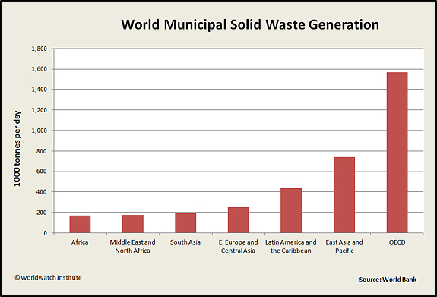
Business Problem
“ Household as well as Industrial Waste is getting generated at an exponential level regularly. Industries spend on waste segregation which also produces more waste to deal with. This can be avoided if we proactively select only the right input material at the source.
There is a dire need to sync waste processing with effective means of usage making a environment friendly and garbage free world in the coming years. ”

Slide 3
Proposed Solution
IMPLEMENTATION
Sensors at the base of dumpster truck gauging calorific value from the moisture of wet waste.
Leverage IOT to allow Biofuel factory to select the most useful waste carrying trucks thereby eliminating the need for segregation .
Predict the quality and quantity of the bio fuel using data about the waste with manufacturing process variables
Optimizing the quantity & quality of output subject to environmental, economic & process constraints.
Refine the variable values and coefficients of prescriptive model using machine learning over time.
Leveraging Predictive & Prescriptive Analytics models coupled with real time data via IOT enabled sensors to forecast & optimize industrial production process
Predictive model
Predicting demand
Predicting quantity, quality of produce on the basis of input & manufacturing conditions
Prescriptive model
Factor in variables like contractual agreements, that are frozen over time.
Optimize the variables of predictive model subject to maximize/minimize cost function.
Coefficients of the ensemble models are refined over time using feed forward method.

Slide 4

Proposed Tech Stack
Hardware
Arduino Uno + Internet Module
GPS Sensor
Calorific Estimator Sensor
Software
Machine Learning & Analytics
Python
R
Spark – Mlib (Depending on Data Size)
SQL
Tableau/PowerBI
Arduino Interfacing
Python

Slide 5




Households
Vegetable Vendors & Marts
Agri Farms
Caterers - Events
Canteen
Collection Centers
Restaurants
Variables - Truck
Calorific Value of Waste
Source Type
Quantity (KG)
Time Stamp
Location
Route Taken
Time taken
Money charged by contractor
Daily Contract Quantity
No. of Trucks
Contractor Area
Sources of Waste
Variables – BioFuel Plant
Processing Cost
Ouput Quantity
Temperature
Pressure
No.of Vats
Vat Size
Stirring Rate
Fermentation Time
Total Time per batch
Additives Quantity
Additives Price
Other Process Variables
Quantity
Price
Industry Sector
Demand Time
Location / Geography
Variables - Demand
Variable Interaction Diagram

Slide 6
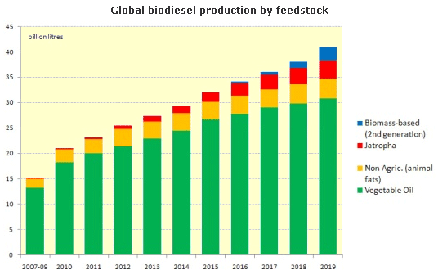
Market Position/Placement
Rate of waste generation is way more than waste utilisation.
Waste management is becoming a big challenge and there's a complete lack of ways to tackle it effectively.
There's a need for eco friendly alternatives, a strong push for such fuel which is less contaminating and doesn’t require a drastic change of technology.
The following users can be first direct and primary market placements for such a setup:
1. Government : Nagar Nigams/ Municipal Corporations
of every district / ward / city
2. Users of Bio fuel such as
- Refineries, who mix it petroleum
- Farmers trying to find an eco friendly alternative
3. Energy generation aggregators/agencies
The applications can further be extended to various other unexplored sectors such as transportation, cooking, Oil spills & grease cleaning agents and lubrication.

Slide 7
Effort and Cost of Implementation
Effort 1. Hardware - IOT Interfacing & Setup 2 Persons * 96(8 Hours * 6 Days * 2 Weeks) = 192 Person Hours
2. Hardware - Sensor R&D
Persons * 94.5(9 Hours * 7 Days * 1.5 Weeks) = 189 Person Hours
3. Software - Machine Learning & Analytics
1 Person * 75(5 Hours * 5 Days * 3 Weeks) = 75 Person Hours
Cost
Hardware
₹800 + ₹30,000 + Extra ~ ₹35,000
2. Software
Licensing Expense – Vendor Quote

